Slide 1

Threading Vs Processing
by Alex Joslin

Slide 2
Defining a Thread
Wikipedia definition:
In computer science, a thread of execution is the smallest sequence of programmed instructions that can be managed independently by a scheduler, which is typically a part of the operating system.
Simpler definition:
A thread is a single sequential flow of control within a program.
Multithreading is running more than one thread in a program.

Slide 3
Defining a Process
A computer program consisting of 1 or more threads being executing.
Basically, any program running on your computer is a process.
Multiprocessing is running two or more processes simultaneously.

Slide 4
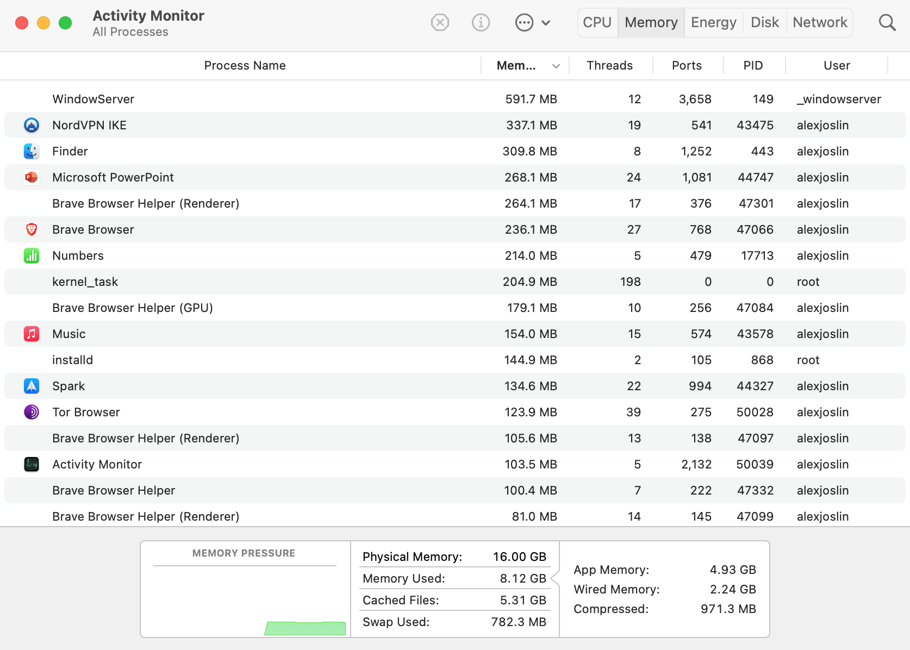
Activity Monitor on Mac

Slide 5
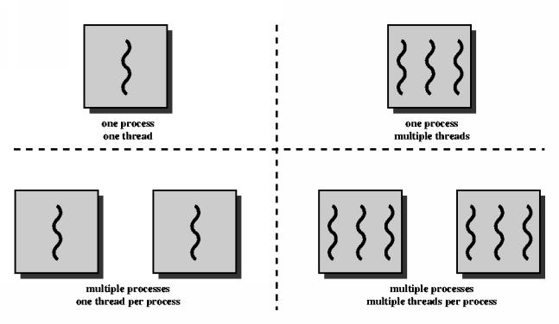

Slide 6
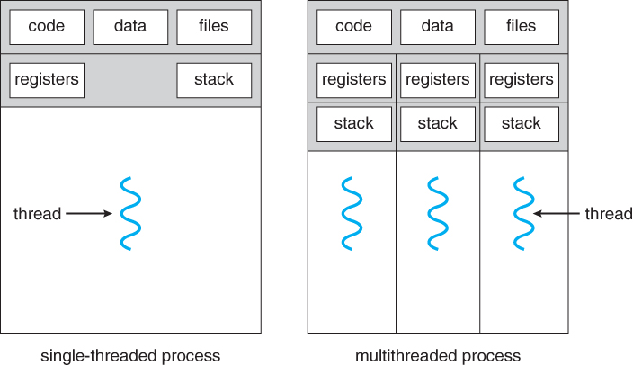

Slide 7
Threading | Multiprocessing
Threads are not independent from each other. They share the same memory. | Are independent from each other.
Use less memory | Use more memory
Faster to create and destroy | Slower to create and destroy
Does not run code at the same time. | Runs code at the same time.
I/O Bound | CPU Bound

Slide 8
Threads (I/O Bound) vs Processing(CPU Bound)
I/O Bound tasks where you are waiting for input and output operations to be completed and not using the CPU that much. Like reading from files, downloading things online, networking requests.
CPU Bound tasks where you are crunching a lot of numbers, uses the CPU and that take up computing power.

Slide 9
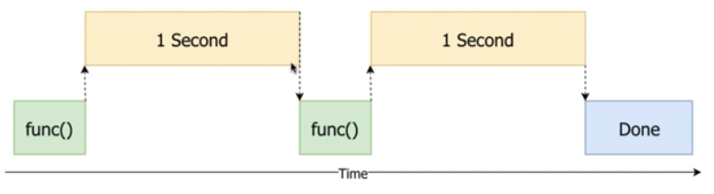
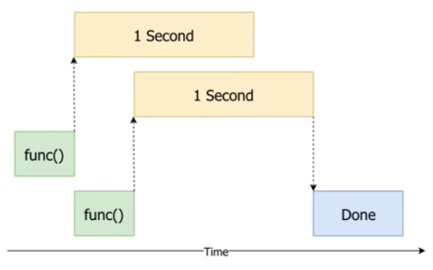
def func(): print("Sleep for 1 second") sleep(1) func() func()
thread 1
Using Threading
thread 2

Slide 10
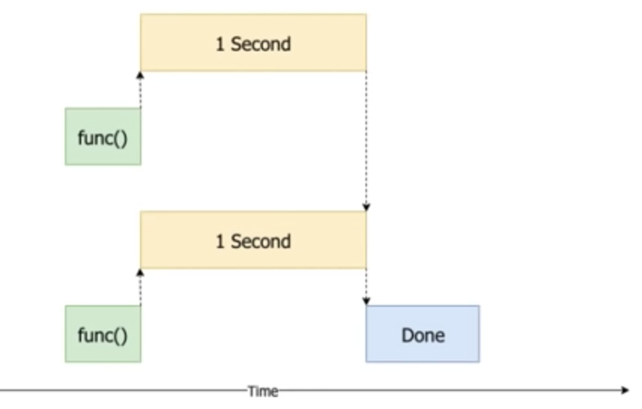
def func(): print("Sleep for 1 second") sleep(1) func() func()
process 1
Using Multiprocessing
process 2

